Slide 1
Year 8 Art ‘Multiculturalism’
Joseph.Wilson

Slide 2
Contents
List the following items as they appear in order of your presentation:
Artist ‘REFLECTIVE’ Statement MIXED MEDIA (50-100 words)
Resolved 2D Portrait
Documentation; Final Portrait, Photos of Work in Progress; Line, tone, colour, shape
Extension task; PhotoShop
2D Printmaking
Response Tasks ; Archibald research, Del Barton notes
BIBLIOGRAPHY

Slide 3
Artist Statement: 2D Mixed Media Task #3 Year: 2021 Media: Mixed Media Dimensions: A4
In no more than 100 words, your artist statement needs to address:
Describe the images in your portrait.
What is the meaning/message of your work – what symbols have been used? Cultural?
Did anything influence you? Artist?
How do you want the viewer to respond to your work?
My 2D artwork displays depictions of my future goals and aspirations.
The red and white ‘rays of light’ illuminating from my body are often found in communist propaganda. It displays my aspiration to one day be a communist dictator. The ‘SUBMIT’ found written in a Cyrillic like font at the top of the artwork conveys a comedic exaggeration of the underlying themes found in most communist propaganda artworks.
I wanted the viewer to understand my ambition and desires to become a dictator while also finding comedic relief in the obvious exaggeration of the message.

Slide 4
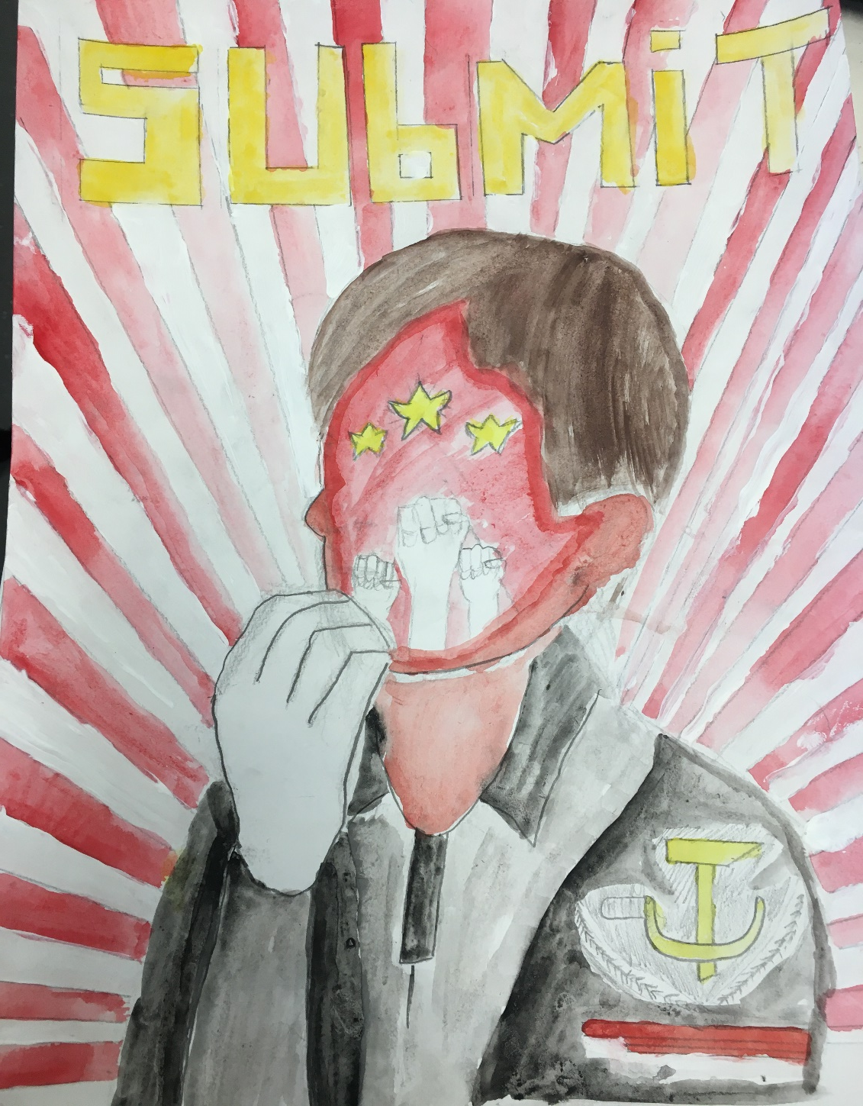
Finished Artwork: 2D portrait

Slide 5
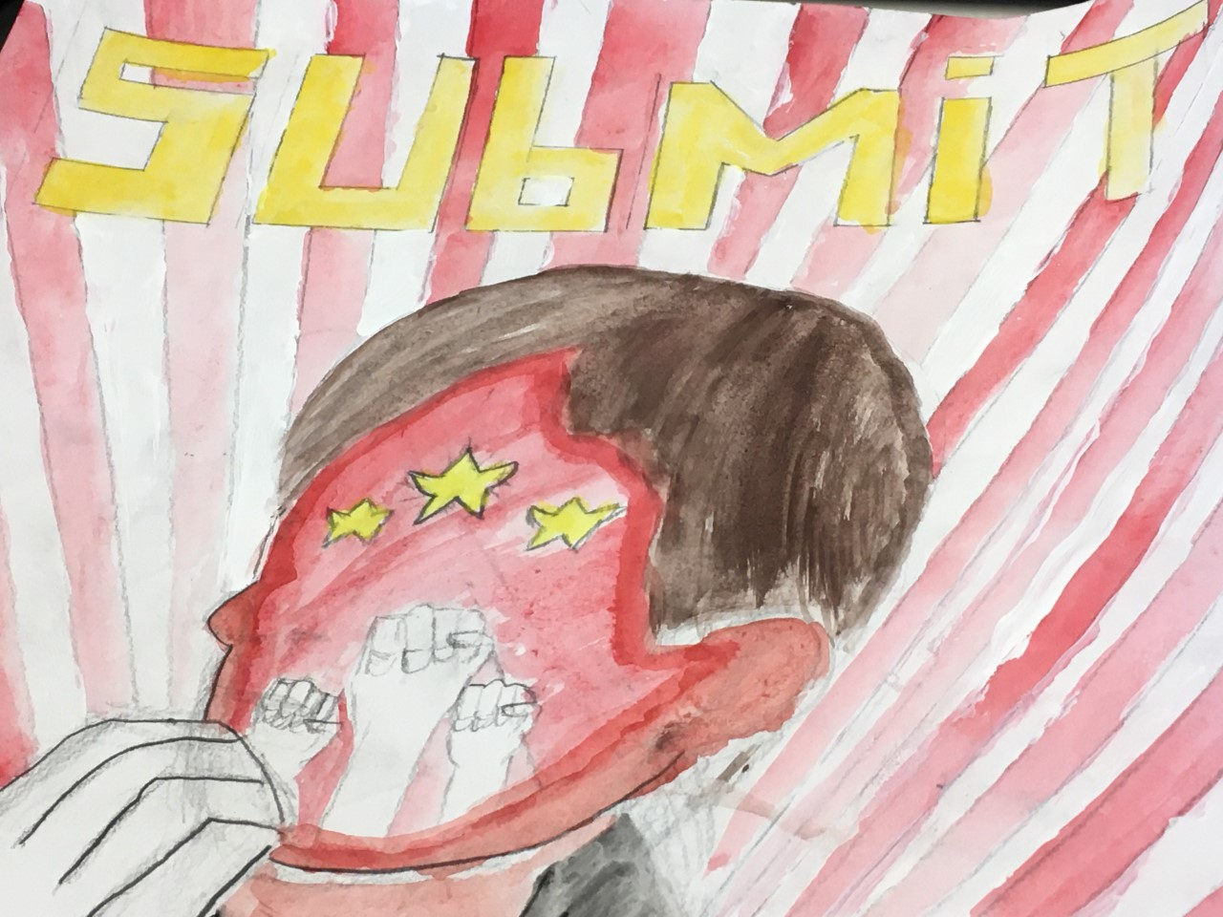
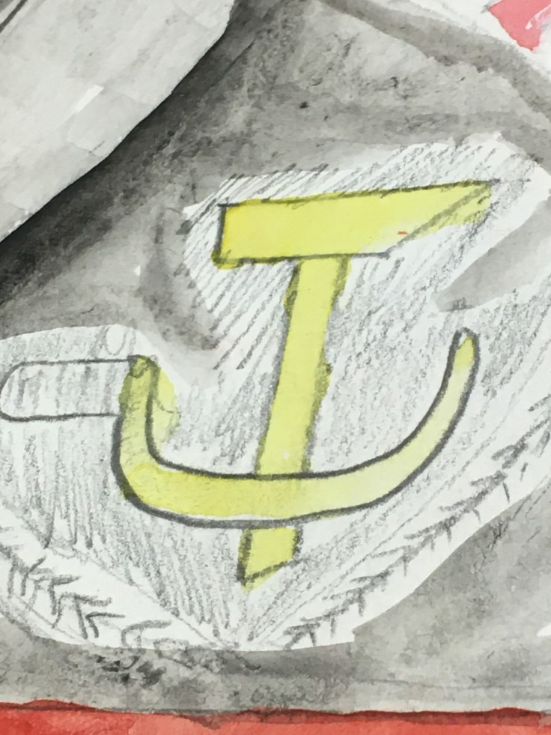
Detailed Photos - close up images of finished artwork

Slide 6

Documentation: 2D Research/Diary
Artist
R e s e a r c h

Slide 7
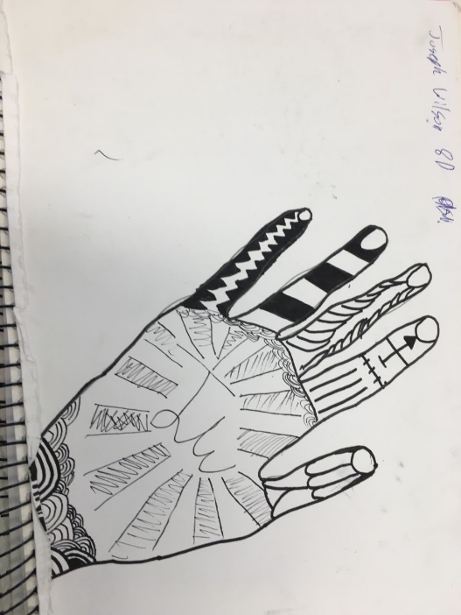
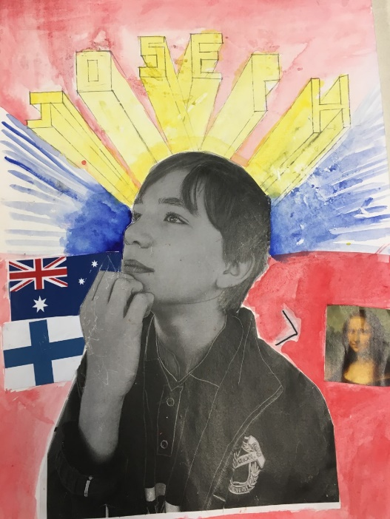
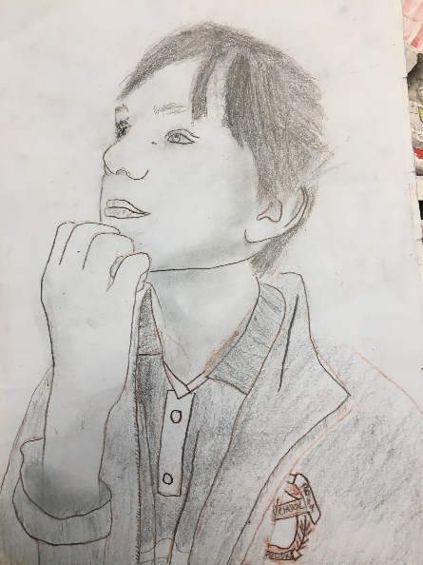
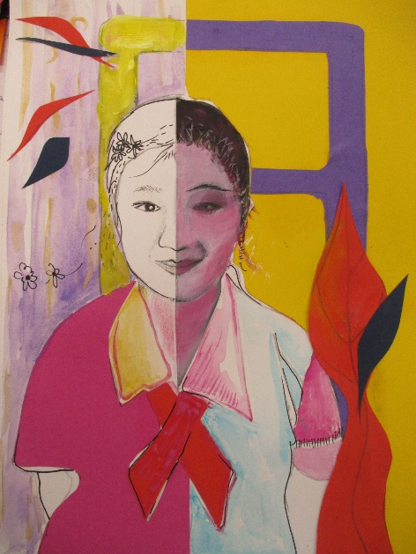
Element experiments: 2D Mixed Media
LINE TONE COLLAGE COLOUR

Slide 8
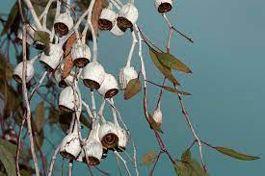

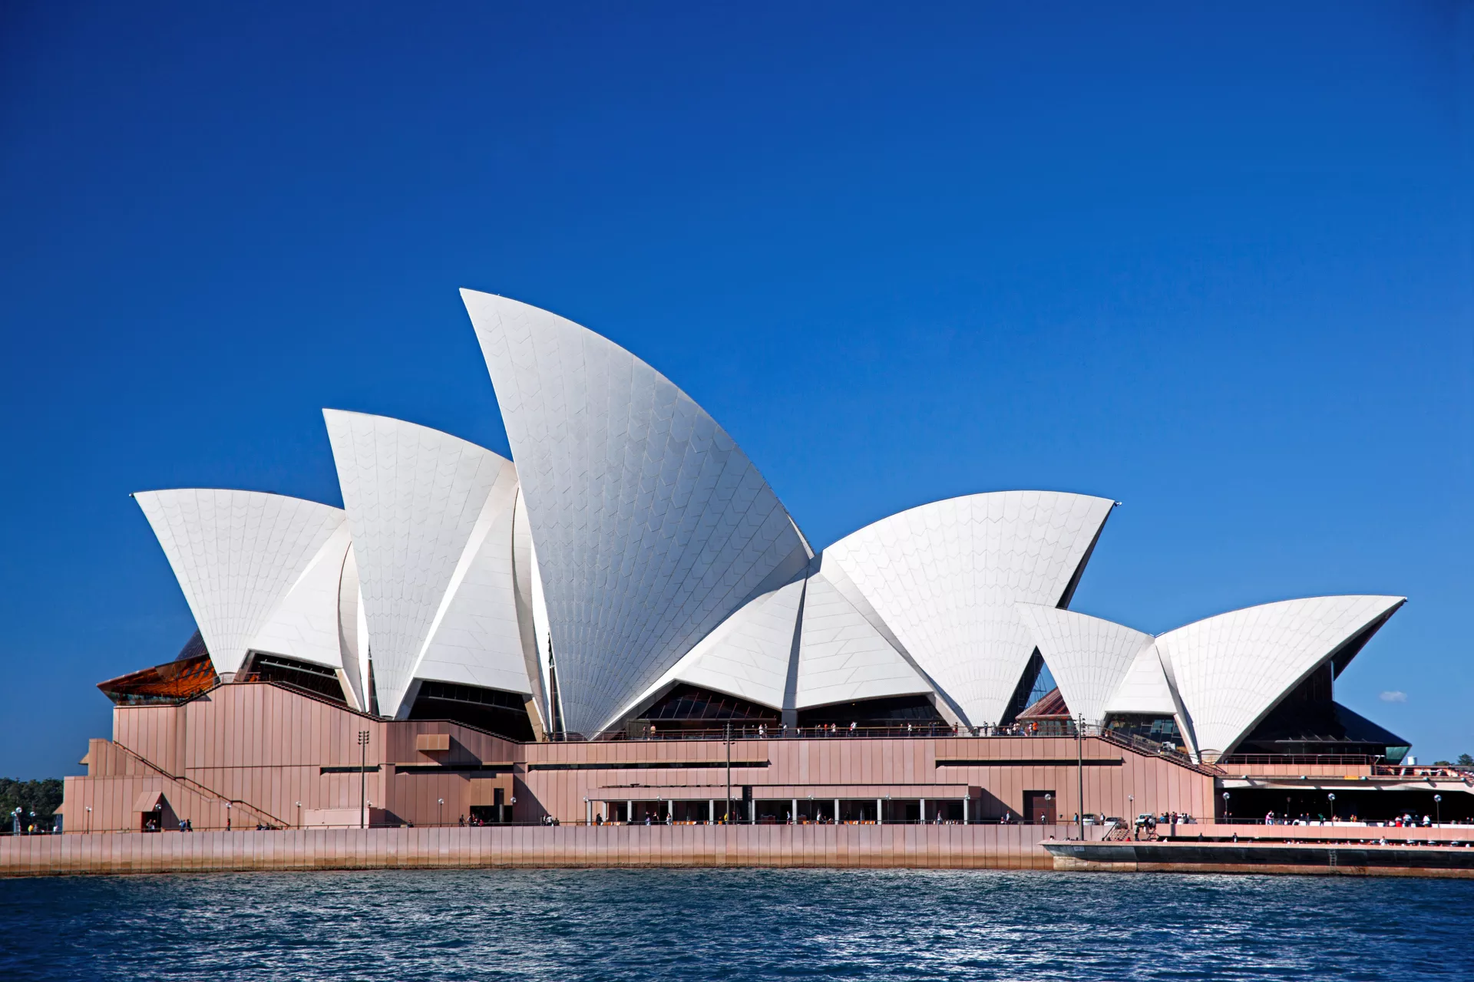


Heritage images for collage

Slide 9

Artwork: Collage

Slide 10
Archibald Prize Response task #1 – Select one
Author: Peter Wegner Subject: Guy Warren
This painting creates a well written and detailed story of Guy Warren and his achievements & personality which have been subject to a century long journey. The Archibald award was first awarded in 1921, a century ago . Which conveniently lies on Guy’s birthyear. However, this is not the reason Peter painted Guy. He painted him to capture his wise, productive and fulfilled life in an immortal vessel.
Author: Kathrin Longhurst Subject: Kate Leberan
A running theme in paintings is to immortalise or freeze an important, passing moment in order to give future viewers a window into a brief moment in the past. This painting follows that trend and aims to provide a window to Kate's daughter about the most important time in her life. She had just recently been the first woman abducted into the Australian songwriters hall of fame. She is also nearing the end of the peak of her 5 decade long career. She wants her to see this

Slide 11
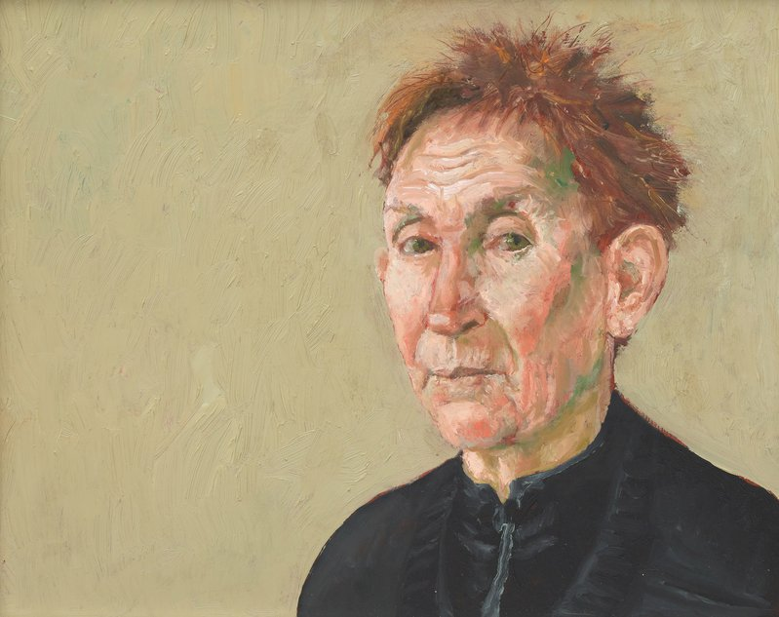
Archibald Prize Response task #2 – Own choice
This portrait is of Jill, one of the artist’s oldest friends. They knew each other in the previous century (1900s, I guess) and have formed a strong bond. As the artist stated that the entire 2 hour painting session flew by as they laughed and chatted. But Jill is often so used to being still in her performances that the sitting session was very easy for her.

Slide 12
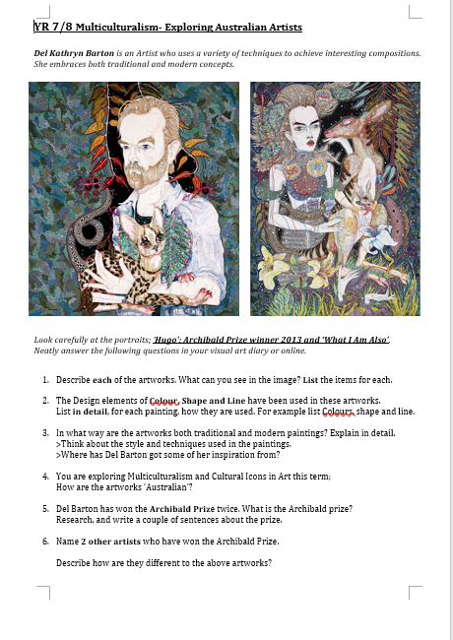
Del Kathryn Barton

Slide 13
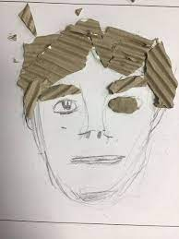
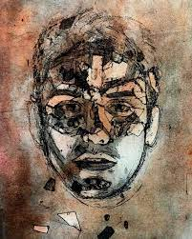
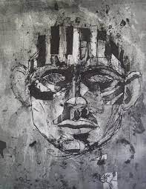
2D Printmaking

Slide 14
Bibliography:
List all references – minimum 3

